Slide 1

INNOVATION
OF PREDICTING IMDb SCORE

Slide 2
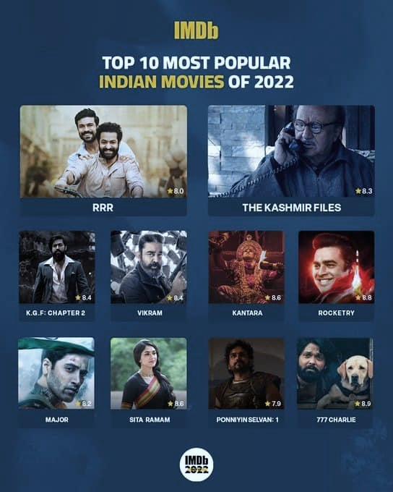
Objective:
IMDb?
Our object is to build a system to predict IMDB users’ rating about movies with different algorithms and compare their performance through a benchmark.
IMDb is the world's most popular and authoritative source for movie, TV and celebrity content. Find ratings and reviews for the newest movie and TV shows.
What is the problem:
The problem can be rephrased as which kind of algorithm could provide the most accurate recommendation for IMDB users.
INNOVATION
OF PREDICTING IMDb SCORE

Slide 3

IMDb?
IMDb is the world's most popular and authoritative source for movie, TV and celebrity content. Find ratings and reviews for the newest movie and TV shows.
Objective:
Our object is to build a system to predict IMDB users’ rating about movies with different algorithms and compare their performance through a benchmark.
What is the problem:
The problem can be rephrased as which kind of algorithm could provide the most accurate recommendation for IMDB users.

Slide 4
Our Solution Different From Others
We use three popular and good performance methods to predict the movie rating and compare their performance.
THANK YOU
SVD
Item-Based Collaborative Filtering (IBCF)
User-Based Collaborative Filtering (UBCF)

Slide 5
Our Solution Different From Others
THANK YOU
We use three popular and good performance methods to predict the movie rating and compare their performance.
SVD
Item-Based Collaborative Filtering (IBCF)
User-Based Collaborative Filtering (UBCF)

